Slide 1
Control of the Type I error and FWE
PermutationTests.jl

Slide 2
Univariate Tests
Random Gaussian data is generated under H0 for many simulations and the observed p-value is recorded

Slide 3
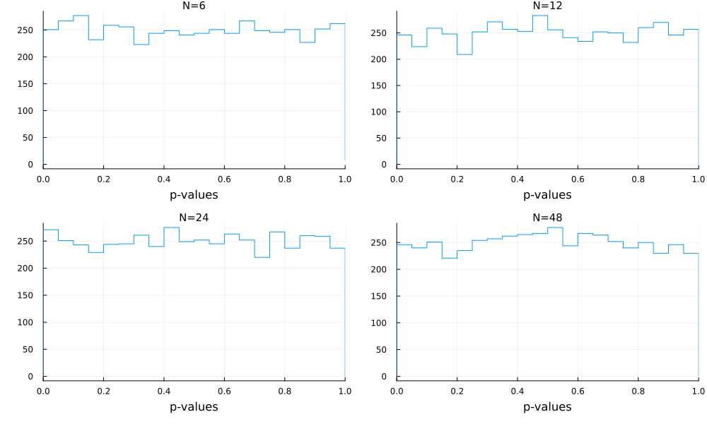
Univariate correlation test. 5000 simulations
The histogram of p-values is uniform, as expected under H0, regardless the number of observations (N)

Slide 4
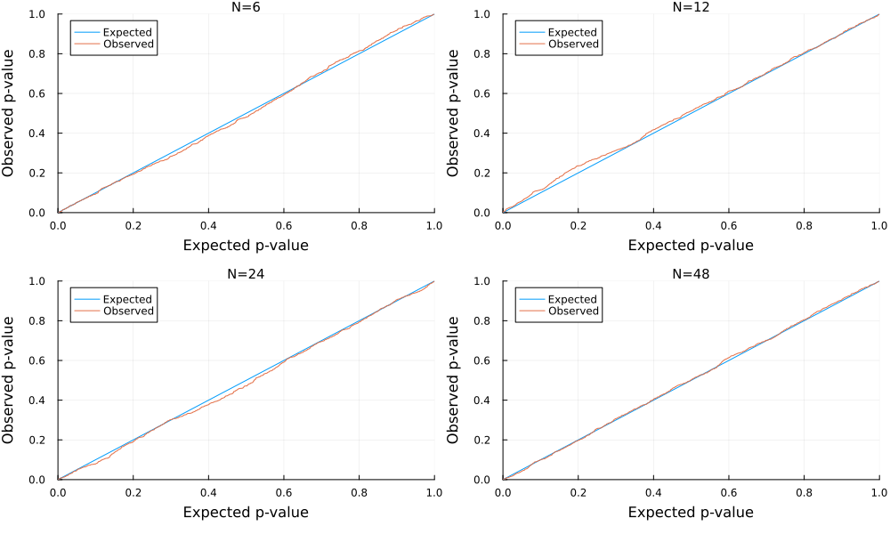
Univariate correlation test. 1000 simulations
The p-p plot is close to a 45° line, as expected, regardless the number of observations (N)

Slide 5
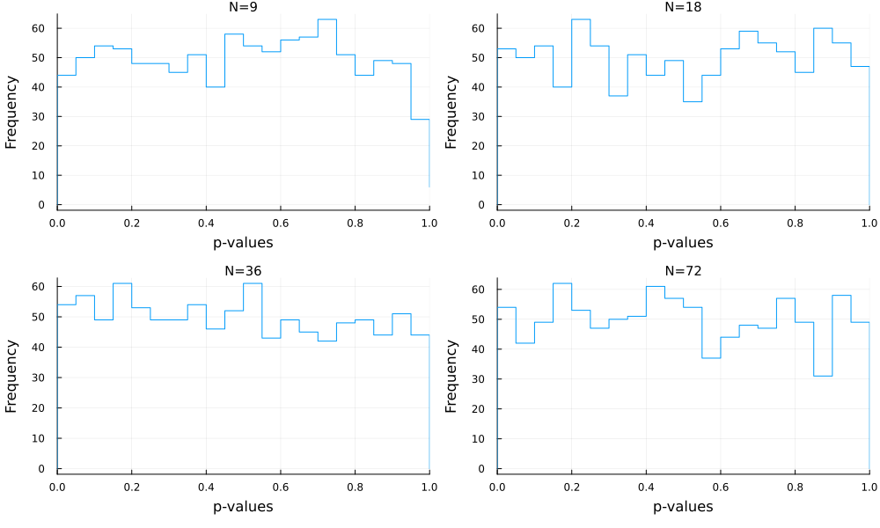
Univariate ANOVA Ind. Samples. 1000 simulations
The histogram of p-values is uniform, as expected under H0, regardless the number of observations (N)

Slide 6
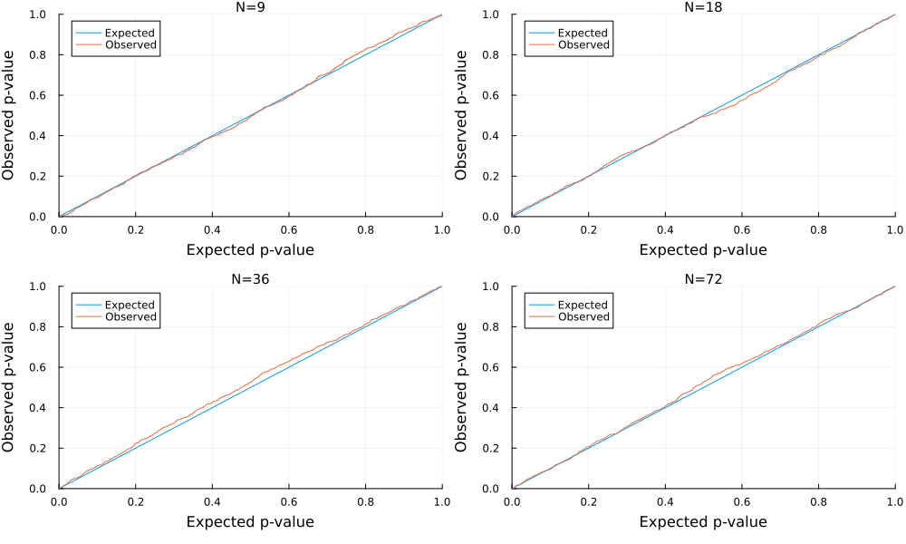
Univariate ANOVA Ind. Samples. 1000 simulations
The p-p plot is close to a 45° line, as expected, regardless the number of observations (N)

Slide 7
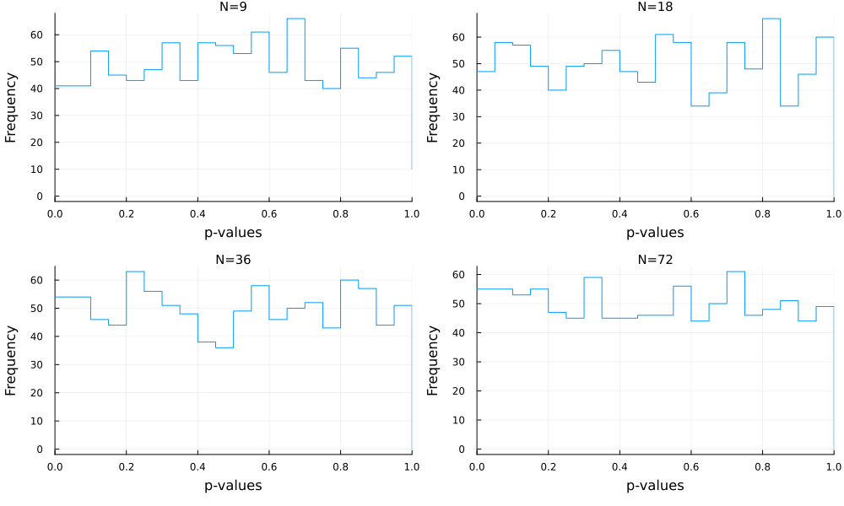
Univariate t-test Ind. Samples. 1000 simulations
The histogram of p-values is uniform, as expected under H0, regardless the number of observations (N)

Slide 8
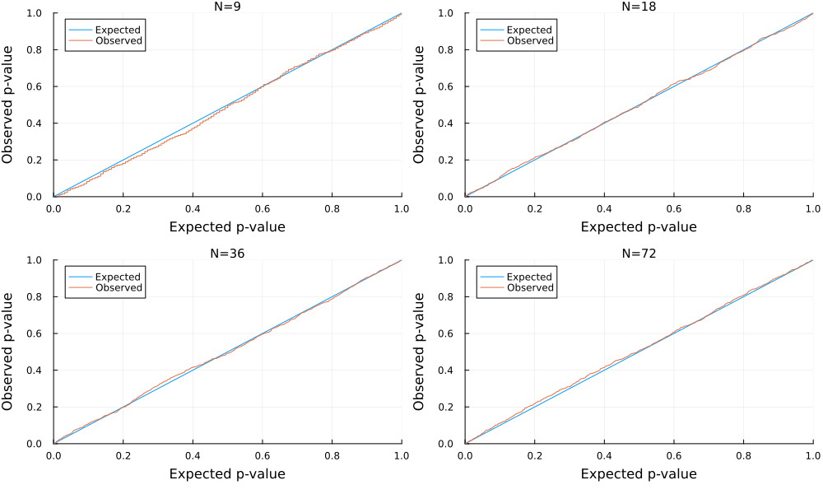
Univariate t-test Ind. Samples. 1000 simulations
The p-p plot is close to a 45° line, as expected, regardless the number of observations (N)

Slide 9
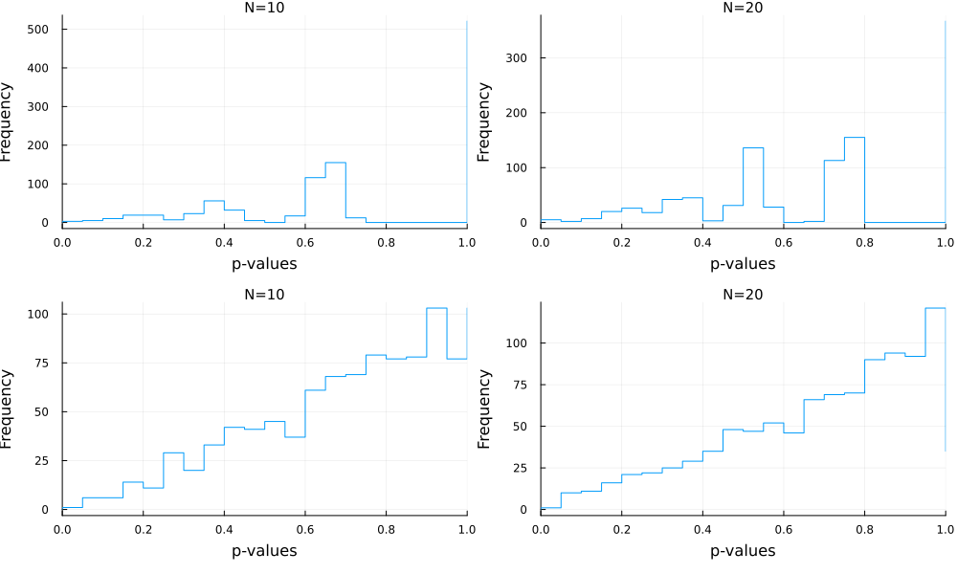
Chi-Square . 1000 simulations
K=2
N=expected frequency of the input table
K=number of columns of the input table
K=4
The histogram of p-values is not uniform. For more than 2 columns, a systematic bias appears

Slide 10
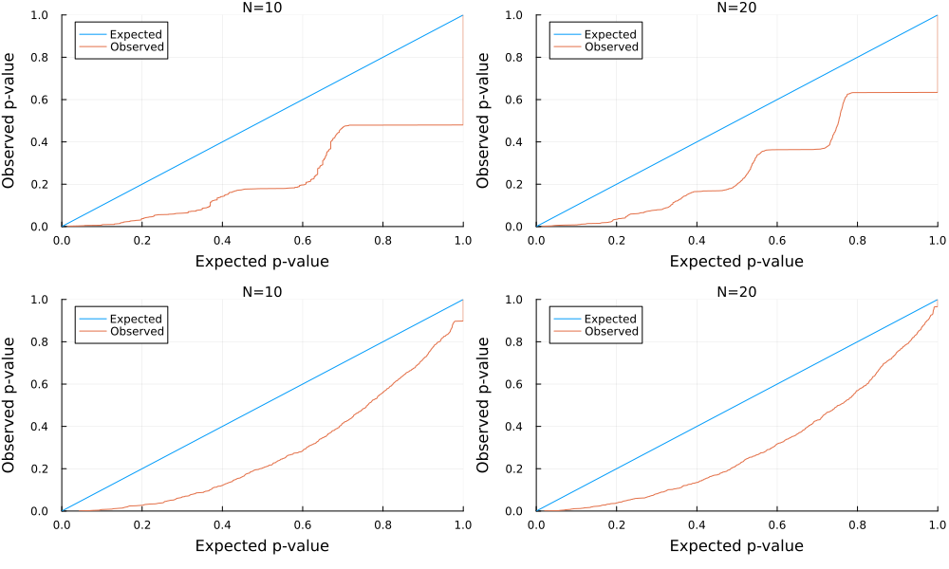
Chi-Square . 1000 simulations
K=2
N=expected frequency of the input table
K=number of columns of the input table
K=4
The p-p plot shows there is a problem

Slide 11
Univariate ANOVA Rep. Measures. 1000 simulations
The histogram of p-values is uniform, as expected under H0, regardless the number of observations (N)

Slide 12
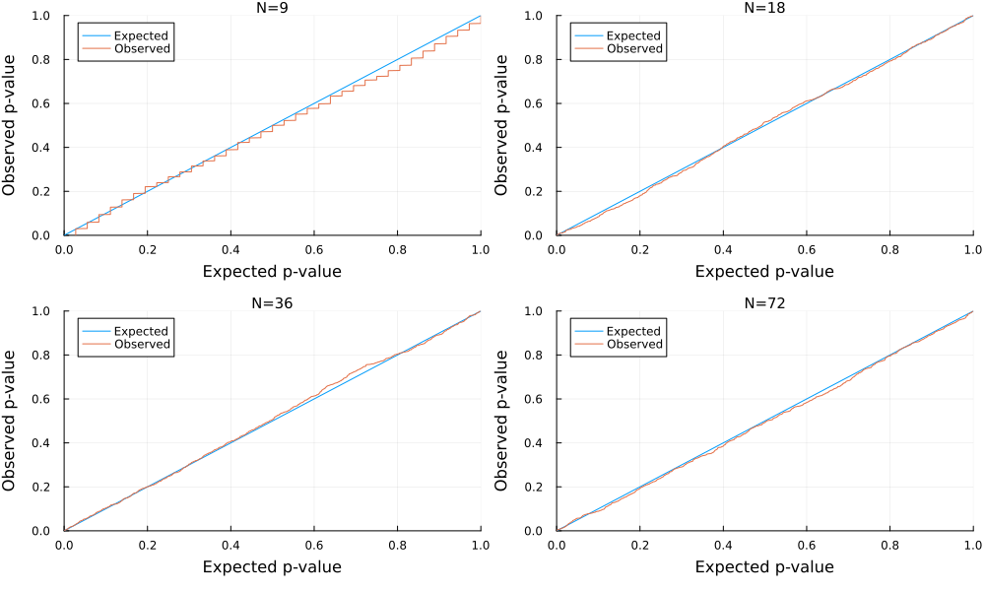
Univariate ANOVA Ind. Samples. 1000 simulations
The p-p plot is close to a 45° line, as expected, regardless the number of observations (N)

Slide 13
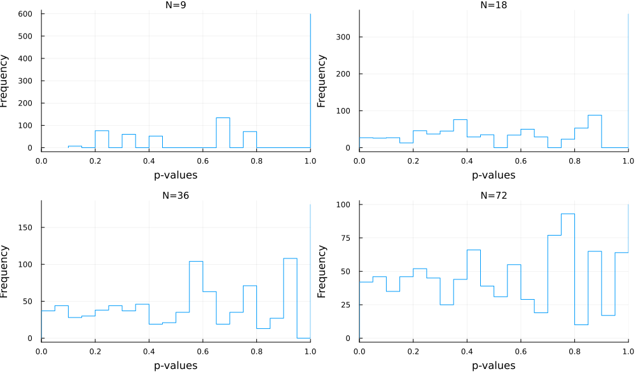
Cochran Q . 1000 simulations
3 columns of the input table
The histogram of p-values is not uniform. The 1.0 value dominates

Slide 14
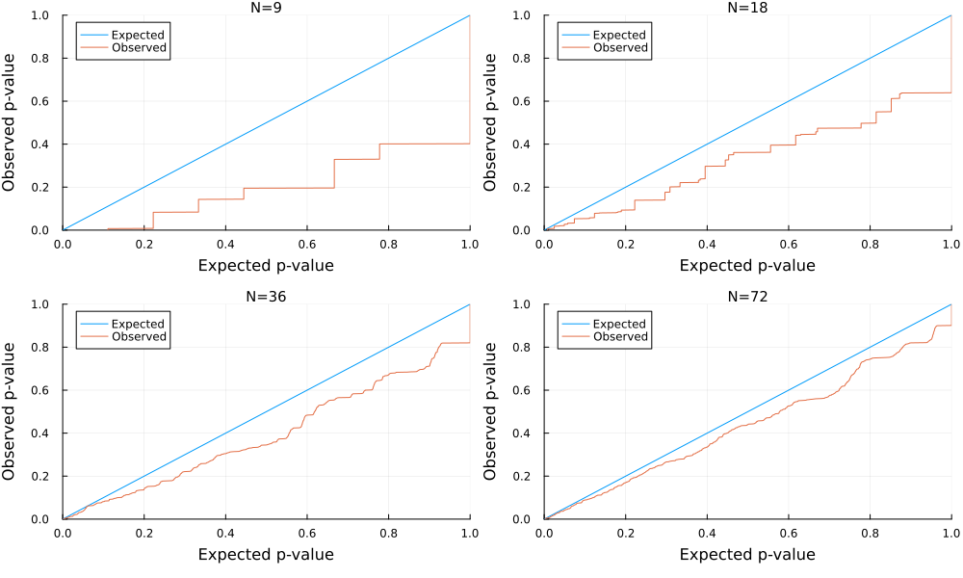
Chi-Square . 1000 simulations
3 columns of the input table
The p-p plot shows approaches the expected for as N grows

Slide 15
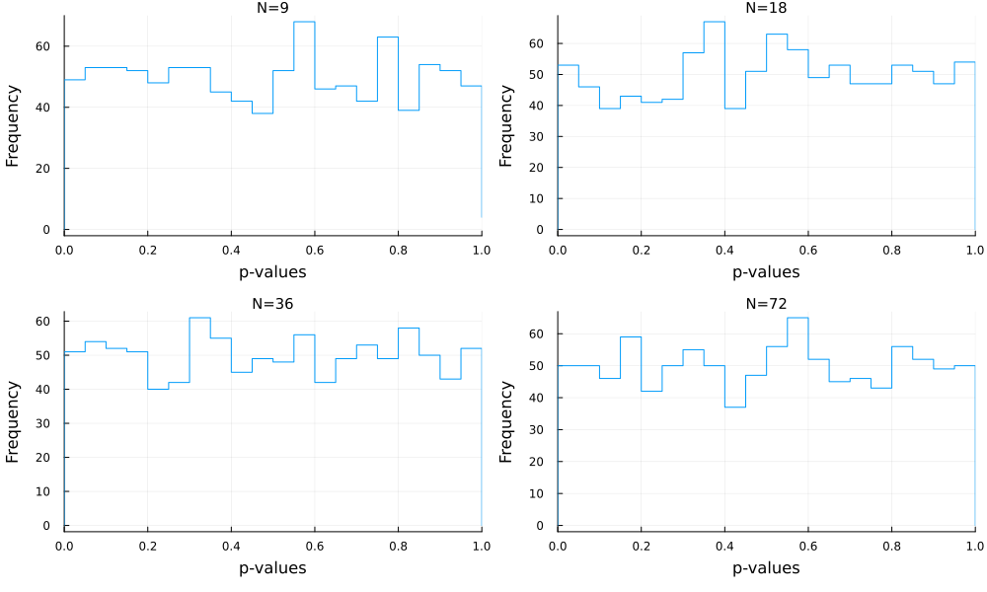
Univariate one-sample t-test. 1000 simulations
The histogram of p-values is uniform, as expected under H0, regardless the number of observations (N)

Slide 16
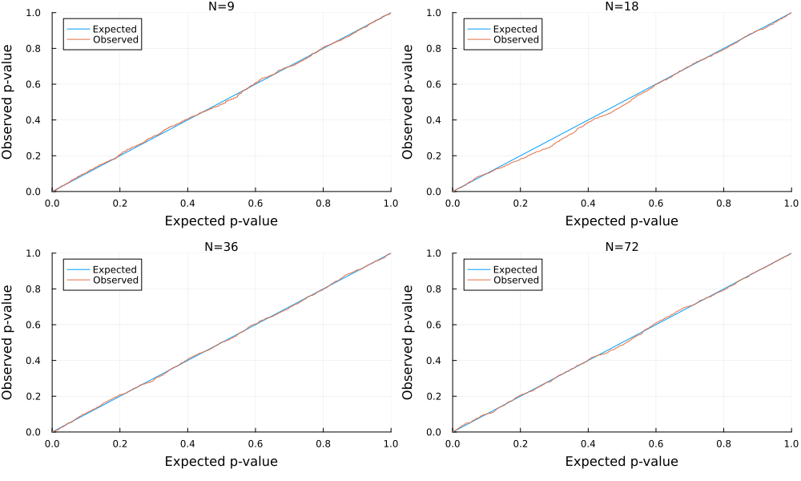
Univariate one-sample t-test. 1000 simulations
The p-p plot is close to a 45° line, as expected, regardless the number of observations (N)

Slide 17
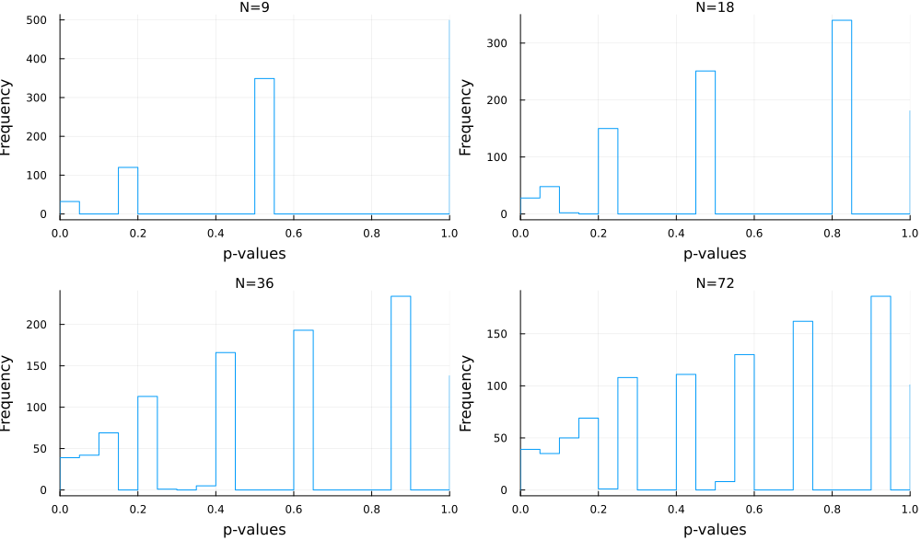
Univariate sign test. 1000 simulations
The histogram of p-values is not uniform, regardless the number of observations (N)

Slide 18
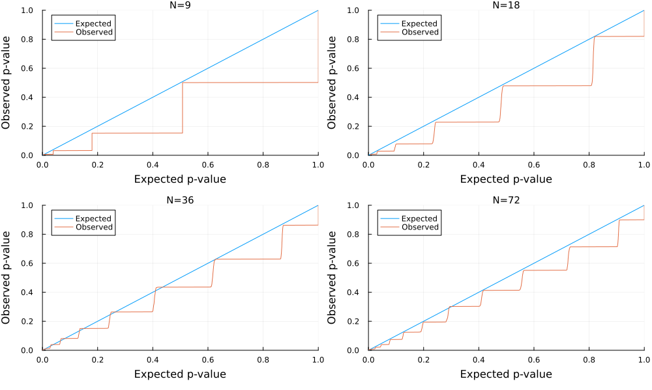
Univariate sign test. 1000 simulations
The p-p plot approaches the 45° line as N grows

Slide 19
Multiple Comparison Tests

Slide 20
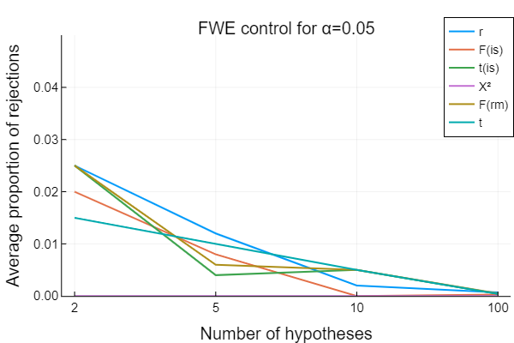
100 simulations generating random Gaussian data. Various settings for the number of observations in each test

